Slide 1
Permissions, Ownership, and Attributes!
This ought to be interesting

Slide 2
Some Definitions to Start Off...
All these things restrict users’ privileges specifically through file access
Permissions: properties that determines users’ powers on file
Ownership: property that gives user/group that owns the file to more specific powers (not really tho)
Attributes: properties that provide more customization to files

Slide 3
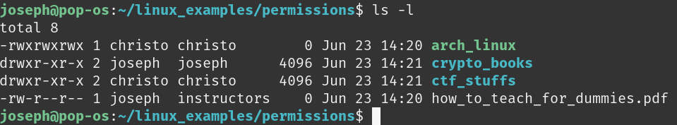
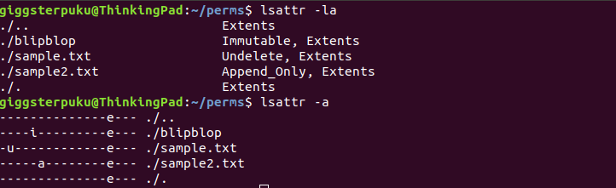
Let’s look at them
Notes:
Now talk about the visuals:
Top panel shows perms and ownership, second shows attrs
ls -la to see perms + ownership, lsattr -a to see attrs
Sidenote: -a option same for both cmds, -l is different
for ls it shows all properties, for lsattr it shows attrs as words instead of letters
First pic: 1st field has perms, 3rd has owner, 4th has group that owns file
Second pic: fields w/ attrs switches whether or not -l is applied

Slide 4
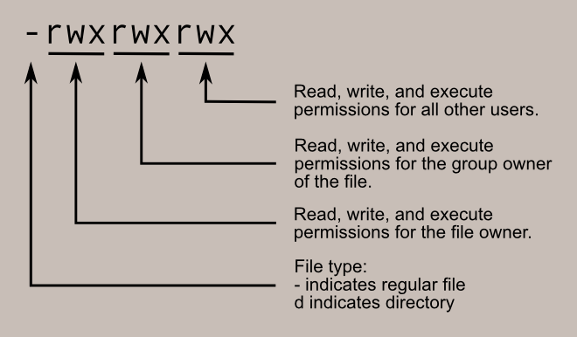
Specifics of Perms
Another representation: 777
Each number represents perms for u/g/o
Each number converted to binary gives rwx info
1 means enabled, 0 disabled
Use chmod [u/g/o]+/-[r/w/x] [file] OR chmod ### [file] to modify these perms

Slide 5

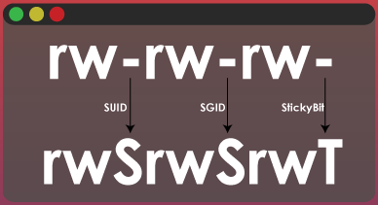
Wot!? You’ve never heard of sticky bits!?
You know it’s interesting, right?
But let’s go over special perms first:
When you ls -l, these will replace the “x parts” of the perms field
SUID and SGID represented as “s” in respective areas, sticky bit represented as “t”
SUID and SGID give perms to run files as user/group
Sticky bits only work on dirs
Anyone can modify it
Change SUID: chmod u+/-s [file]
Change SGID: chmod g+/-s [file]
Change sticky bit: chmod +/-t [file]
Notes:
Set owner User ID up on exec
Set owner Group ID on exec

Slide 6
Change ownership
chown [owner]:[group] [file]
Can use chgrp [group] [file] if only changing group

Slide 7
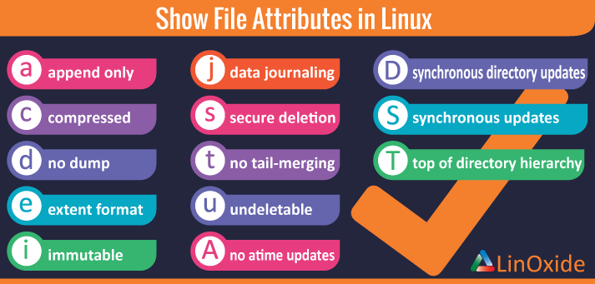
Attributes
There’s lots, but let’s cover the major ones
Append only - can only edit file by adding lines to file (redirecting output to file)
Extent format - allows file to be mapped to extents
Immutable - not modifiable (like a constant in a program)
Undeletable - allows recovery of file data after removal
Change them using chattr +/-[attrs] [file]
Notes:
Extents are special storages in file system where a file’s data is stored; reduces file fragmentation/scattering error (file broken up into other areas of data, making it harder to read and write data)

